Slide 1
CONWAY’S GAME OF LIFE
Jack Pham, Walter Gula, Ibrahima Bah

Slide 2
CONWAY’S GAME OF LIFE
Jack Pham, Walter Gula, Ibrahima Bah

Slide 3
RULES
GRID
DEATH BY
Overcrowding
Loneliness
Live By
Having Neighbors
BIRTH BY
Having Neighbors

Slide 4
USER
Problem
Find out what state
of nodes would be
stable
Input
Live/Dead Nodes
Output
Final State of Nodes

Slide 5
DESIGN
HTML
Tables
JavaScript
Buttons
Features
Login
Patterns
Increment Generations

Slide 6
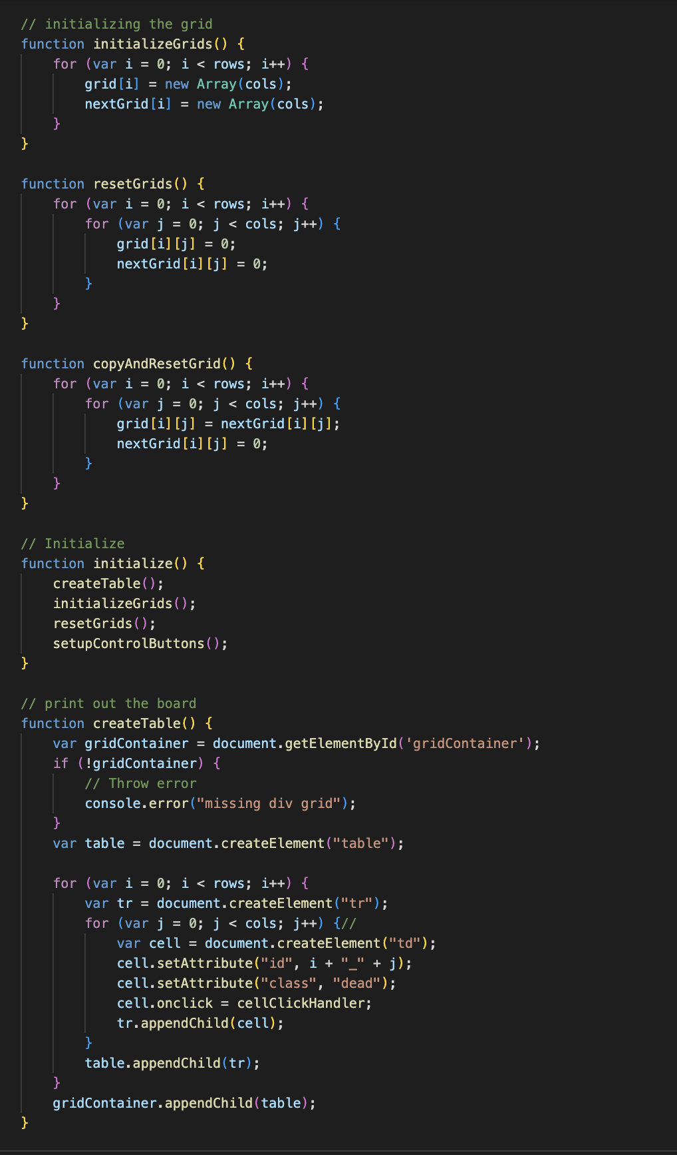
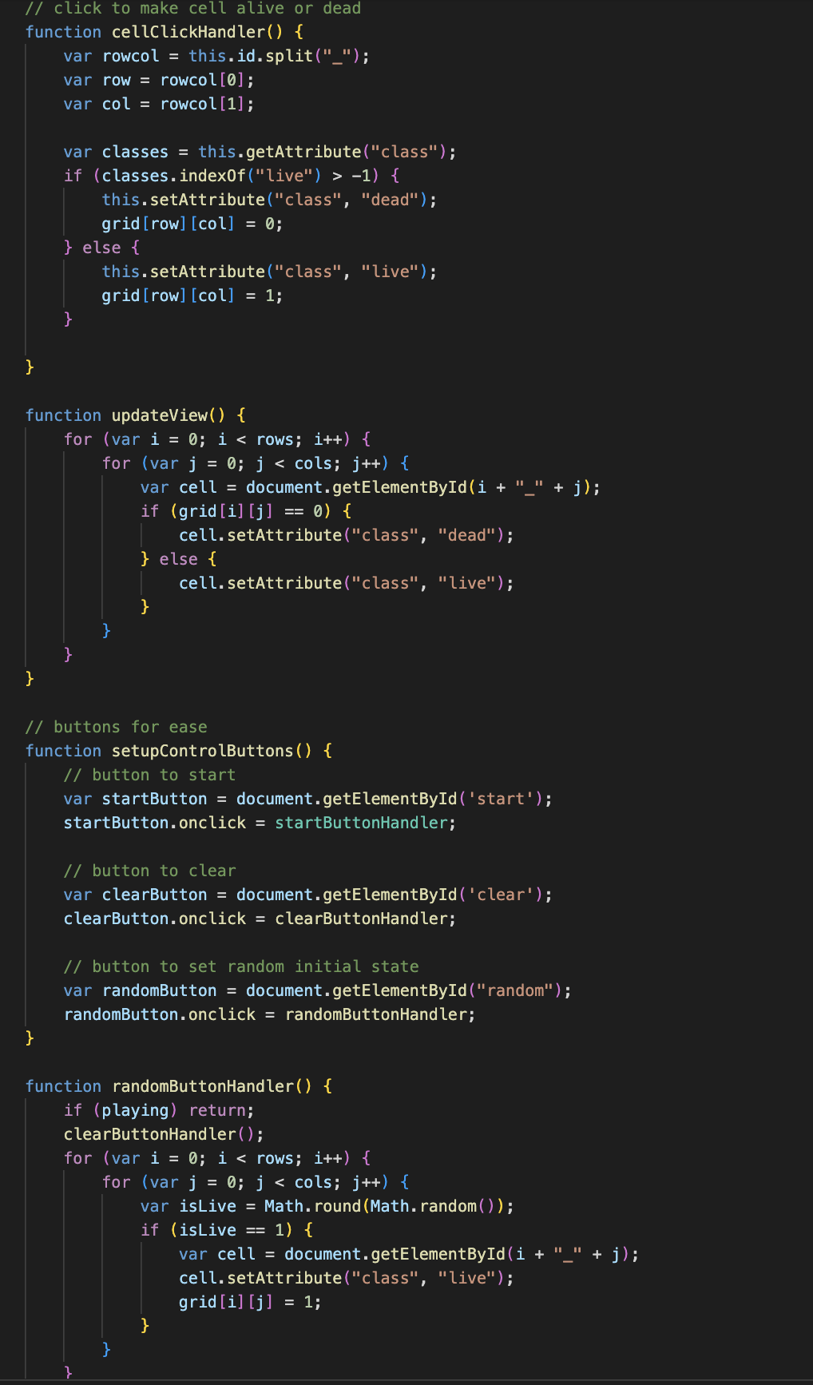
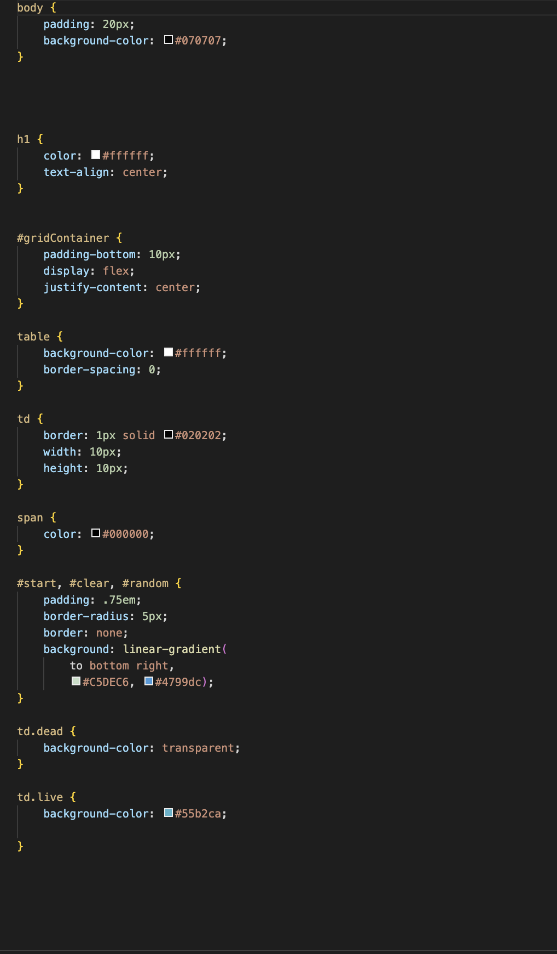

Slide 7
TESTIING
Test Case
Confirm patterns
behave
Test Through Gameplay
Casual attempts to play
Bugs listed through Discord chat
Reported and fixed immediately

Slide 8
ROLES
https://docs.google.com/document/d/1MxpqEzCB0DQIcNN9KrRQozJPf7bVvqzwma0t6ULxST4/edit?usp=sharing

Slide 9
THANK YOU

